Slide 1
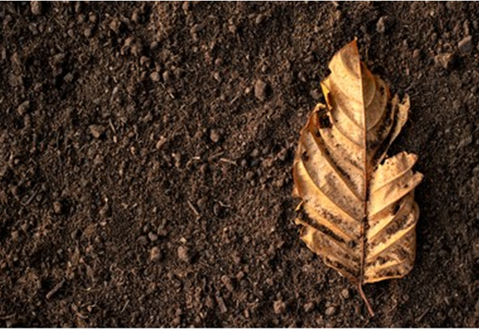
Leaf Based Fertilizer : Sustainable Approach
“Exploring the Potential of Leaves
in organic farming”

Slide 2
Why plants needs fertilizer ?
Nutrient supply
Soil enrichment
Disease prevention
Water retention

Slide 3
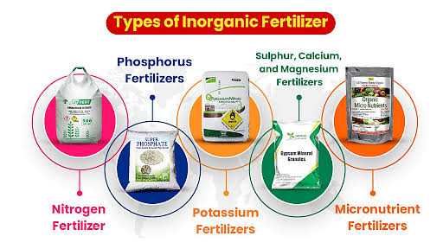

Slide 4
What are the effects on soil ?
Effects
Infertile soil
Acidic soil
Ground water pollution
Excess growth

Slide 5
What is the process ?
Collect leaves
Decomposition begins
Moniter and maintain
Decompositon complete
Add decomposer
Optimize Environment
Humus formation

Slide 6
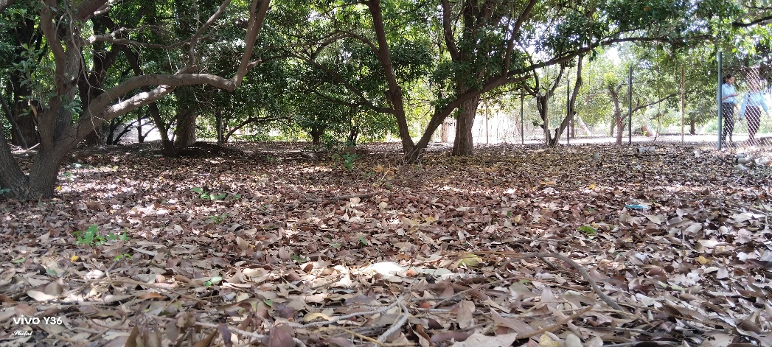
Collection of raw material (Leaves)

Slide 7
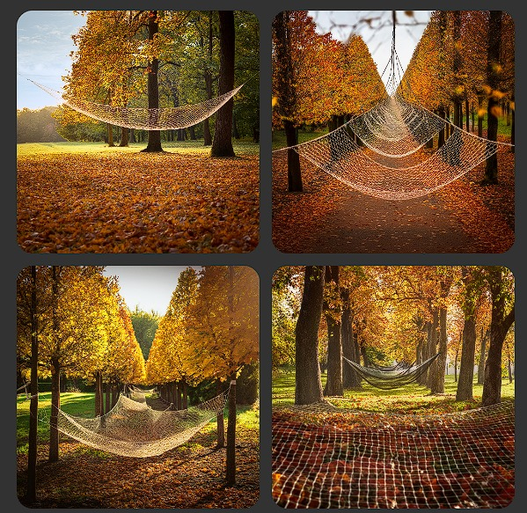

Slide 8
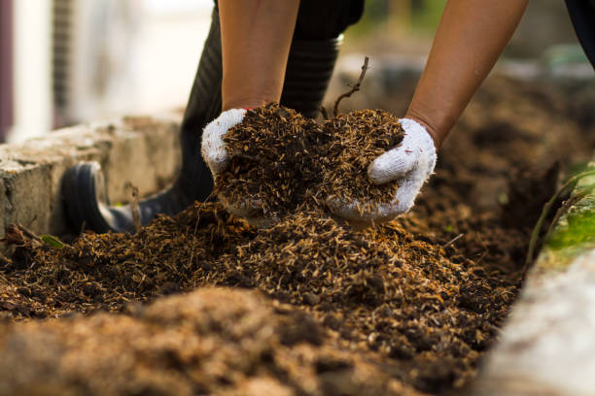
Leaf composting pit

Slide 9
What are the benefits of organic fertilizer ?
Soil
Plant
Environment
Chemical
Biological
Economic
Benefits

Slide 10
Long-term Benefits
Soil conservation Improved soil health Increased ecosystem services

Slide 11
Conclusion :
Our leave based fertilizer project demonstrates a simple yet powerful solution for a greener,healthear campus by embracing sustainability and waste reduction

